Slide 1

ERISM: Conducting a convergence
analysis to find the minimum mesh size
Isra Al Nour
Summer internship

Slide 2
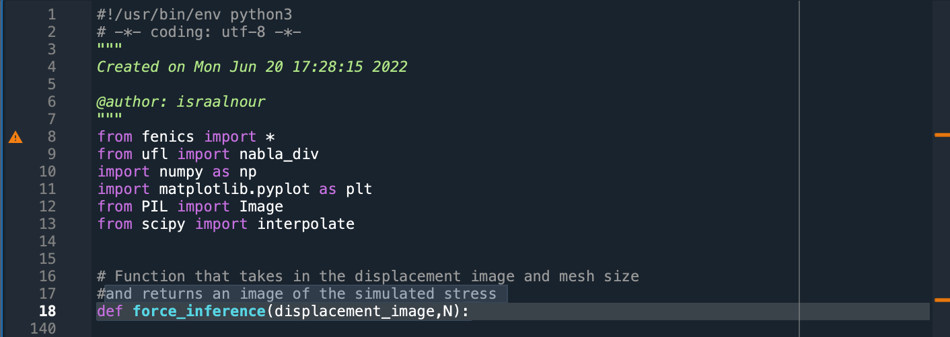
Step 1: Setting up the code

Slide 3
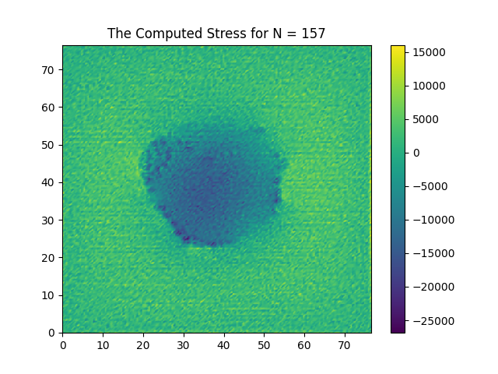
Step 1: Setting up the code

Slide 4

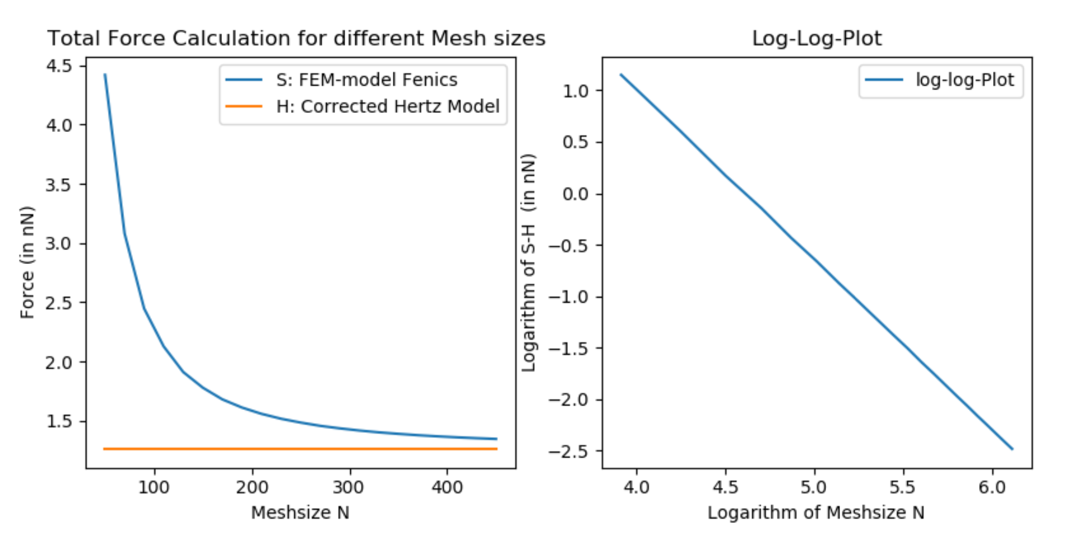
Think: How to perform the analysis?
What results are we expecting?

Slide 5
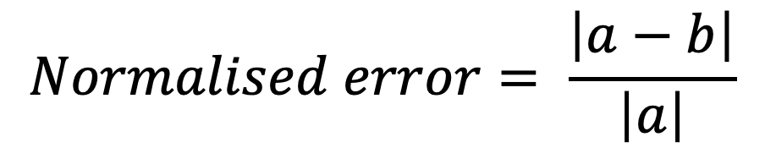
Step 2: Calculating the error
$$Normalised error= \frac{\left|a−b\right|}{\left|a\right|}$$

Slide 6

But then
WE FOUND A BUG
WE FOUND A BUG
How we fixed it

Slide 7
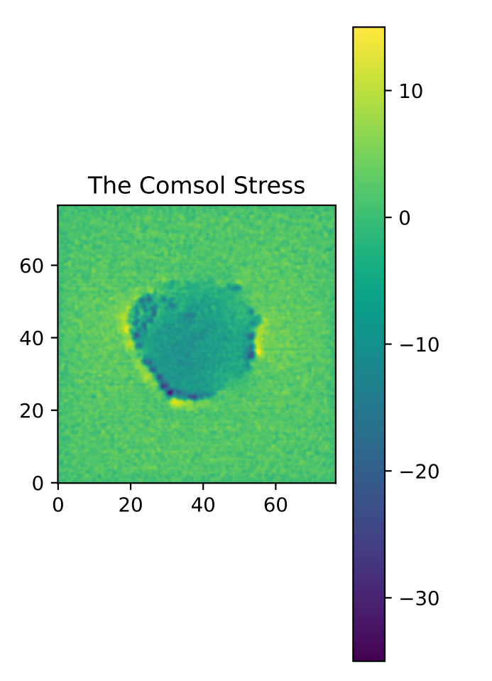
Results: The maximum N?

Slide 8
Results

Slide 9
Results: Changing the order

Slide 10
Results: Changing the order

Slide 11
Results: Changing the order

Slide 12
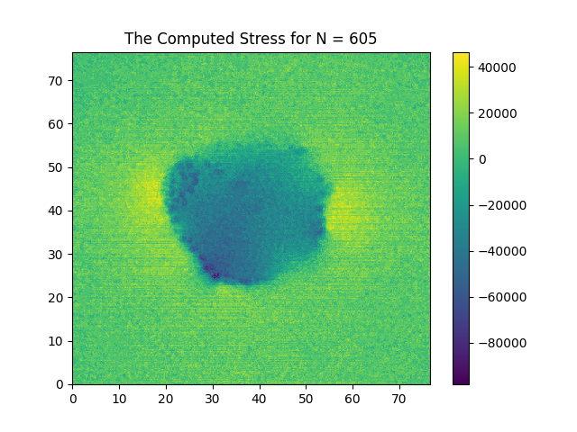
Results: Changing the order

